Slide 1

Vel Tech Rangarajan Dr. Sagunthala R&D Institute of Science and Technology
School of Computing
Department of Computer Science and Engineering
10211CS224 / FULL STACK APPLICATION DEVELOPMENT (JAVA)
END SEMESTER PROJECT REVIEW
Date: 06-05-2026
TICKET BOOKING OF AN INTERNAL DEPARTMENT EVENT
SDG: SDG No – 9-Industry,Innovation and Infrastructure
Presented By:
STUDENT NAME – P.Naga Sai Hemanth
Reg.No-23UECS0984
Courses Handling Faculty:
Dr.Hafizur Rahman
- Associate Professor

Slide 2
INTRODUCTION
1
This project is an internal event ticket booking system for department-level events.
It solves the problem of manual, paper-based event registration and overbooking.
The system improves access to event information, booking, and seat availability.
Users can browse events, filter options, and book tickets securely online.
Admins can manage events, monitor bookings, and control seat limits.
It includes authentication, role-based access, and booking confirmation flows.
The application uses a React frontend, Node.js/Express backend, and MySQL database.
The goal is to make event management efficient, transparent, and user-friendly.
2
3
4
5
6
7
8
9

Slide 3
PROBLEM STATEMENT
1
Educational institutions rely on manual event ticket booking, causing inefficiencies like overbooking and disorganized registrations.
Students and faculty encounter long queues, unclear seat availability, and no real-time updates during events.
This leads to frustration, wasted time, and missed participation opportunities for users.
Administrative staff face challenges with paper-based tracking, error-prone data management, and scalability issues.
Increased workload and reduced event success rates result from these outdated processes.
A critical need exists for a digital, automated system to streamline event management and ensure fair access.
The solution must provide transparent booking flows and enhanced administrative control.
This project develops a secure web application for seamless ticket booking, real-time updates, and comprehensive event administration.
2
3
4
5
6
7
8
9

Slide 4
OBJECTIVE(S)
1
Develop an automated ticket booking system to replace manual processes, enabling real-time seat availability, preventing overbooking, and providing a seamless user experience for students and faculty.
Implement secure authentication and authorization using JWT, along with user dashboards and admin panels, to manage events, bookings, and user data efficiently.
Ensure scalability and reliability through a full-stack architecture (React frontend, Node.js backend, MySQL database) with Docker deployment, supporting high-demand events and comprehensive reporting.
2
3
4
5
6
7
8
9

Slide 5
PROPOSED SYSTEM
1
System Description: A full-stack web application using React for the frontend, Node.js/Express for the backend, MySQL for the database, and JWT for secure authentication, enabling event browsing, ticket booking, and administration.
Event Management Module: Allows admins to create, update, and delete events with details like date, venue, seats, and pricing, providing a centralized dashboard for oversight.
User Registration and Authentication: Implements JWT-based login/signup, supporting user roles (student/faculty/admin) with secure session management and password hashing.
Booking Flow: Users can browse events with filters, view real-time seat availability, and complete bookings with payment integration, generating receipts and confirmations.
Real-Time Updates: Prevents overbooking through database locks and concurrent access controls, ensuring accurate seat counts and instant feedback.
User Dashboard: Provides personalized views of bookings, receipts, and event history, with options to view or print confirmations.
2
3
4
5
6
7
8
9

Slide 6
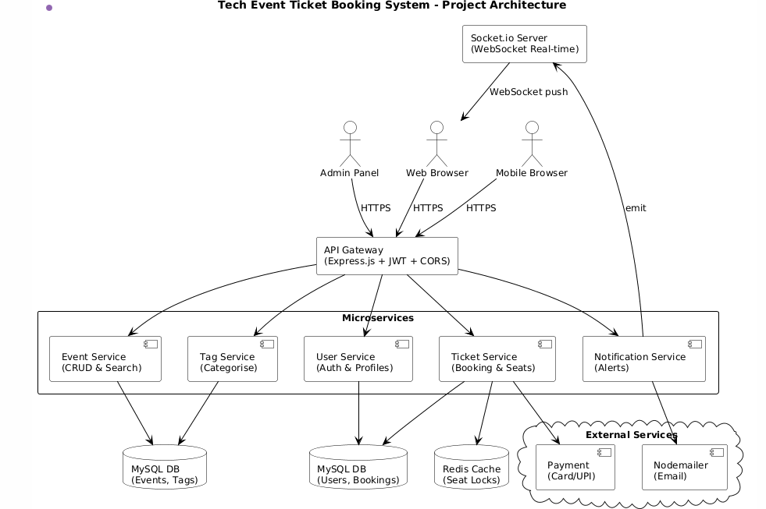
PROPOSED SYSTEM ARCHITECTURE
1
2
3
4
5
6
7
8
9

Slide 7
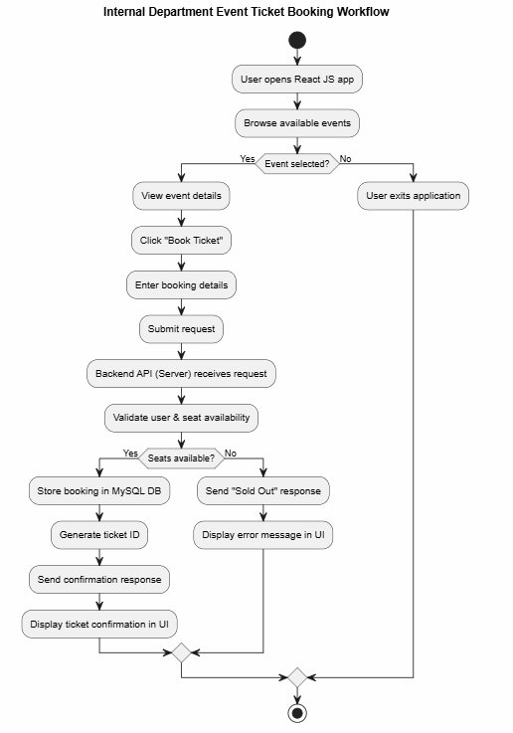
WORKFLOW
1
2
3
4
5
6
7
8
9

Slide 8
TECHNOLOGIES USED
Frontend:
HTML
CSS
JavaScript
React
- Backend:
Node.js,Express.js
Database:
MySQL
Third-Party API:
SMTP for email services
Tools:
VS Code
Hardware/Software Requirements:
Windows
Web Browser(Chrome)
Local Server
1
2
3
4
5
6
7
8
9

Slide 9
MODULE DESCRIPTION
Module 1: User Management
Handles user registration, login, and profile management with JWT-based secure authentication, supporting roles like student, faculty, and admin.
Module 2: Event Management
Manages event creation, browsing, filtering, and details display, allowing users to view real-time seat availability and event information.
Module 3: Booking and Payment Processing
Implements the core booking flow, including ticket selection, payment handling, seat reservation, and overbooking prevention with transaction confirmations.
Module 4: Notification and Communication
Integrates toast notifications for user feedback and optional email confirmations via SMTP for booking receipts and updates.
Module 5: Admin Panel and Reporting
Provides admin tools for event CRUD operations, user management, booking analytics, and reporting for operational insights and decision-making.
1
2
3
4
5
6
7
8
9

Slide 10
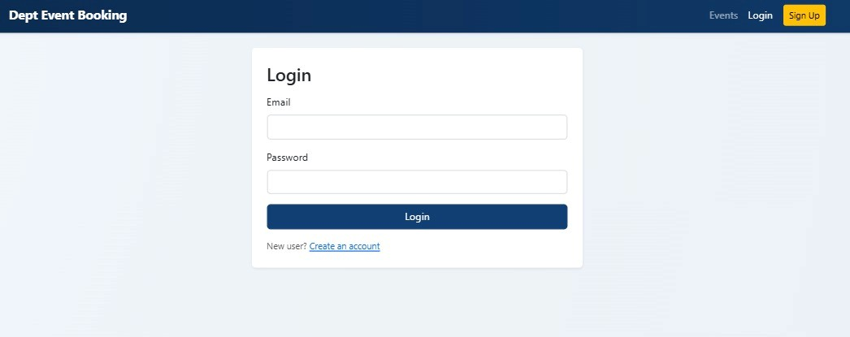
IMPLEMENTATION SCREENSHOTS
Figure:Login Page
1
2
3
4
5
6
7
8
9

Slide 11
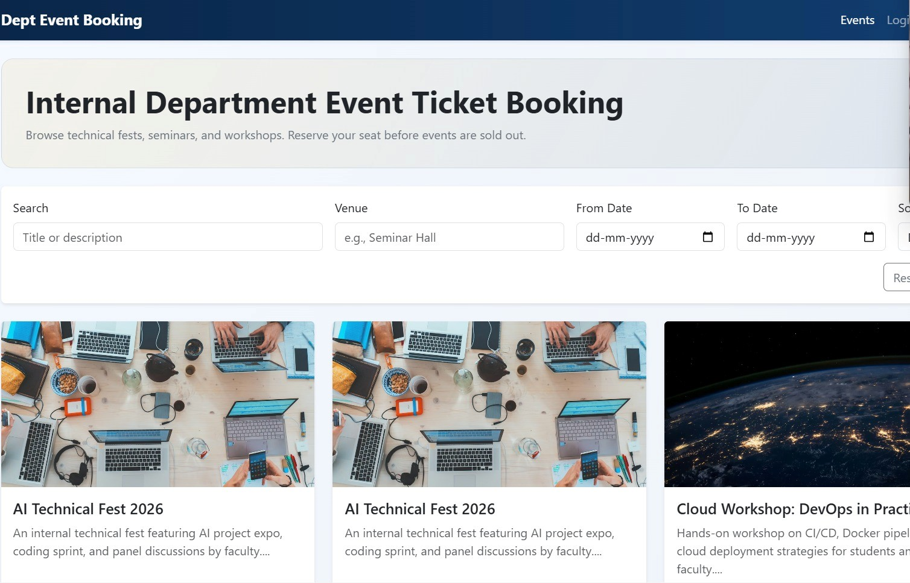
IMPLEMENTATION SCREENSHOTS
Figure:Home Page
1
2
3
4
5
6
7
8(A)
9

Slide 12
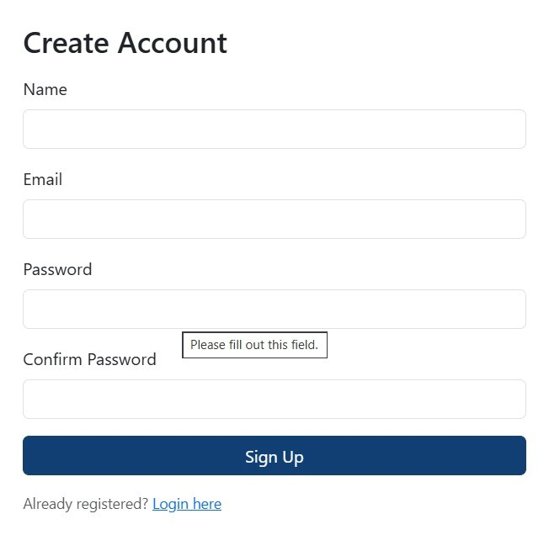
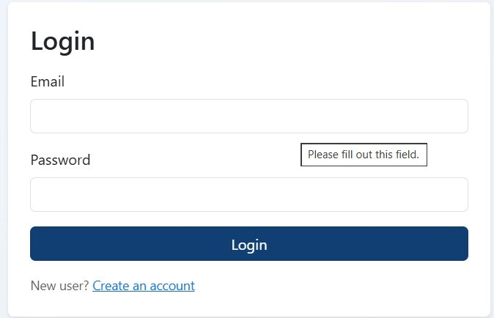
IMPLEMENTATION SCREENSHOTS
Admin Login Page
User Login Page
1
2
3
4
5
6
7
8(B)
9

Slide 13
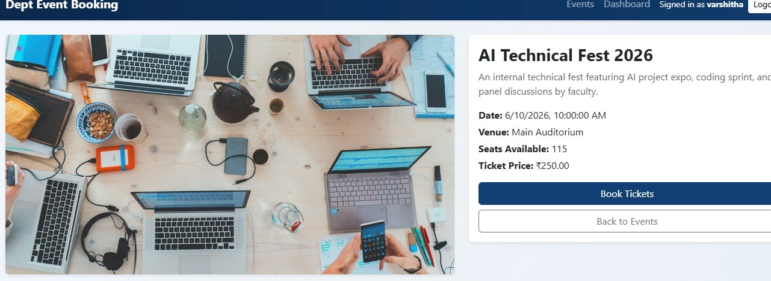
IMPLEMENTATION SCREENSHOTS
figure:Event Details
1
2
3
4
5
6
7
8(C)
9

Slide 14
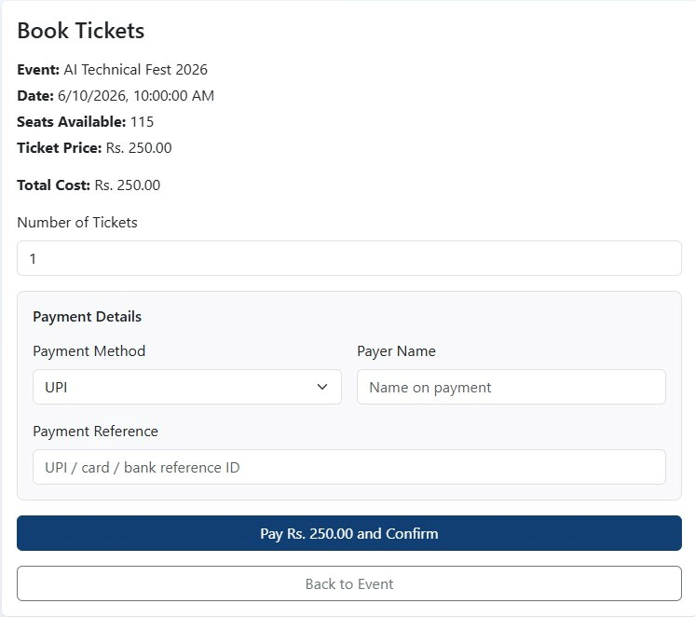
IMPLEMENTATION SCREENSHOTS
Figure:Payment Details
1
2
3
4
5
6
7
8(C)
9

Slide 15
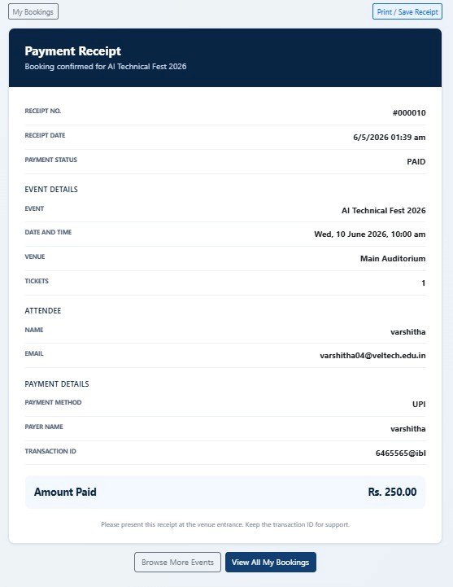
IMPLEMENTATION SCREENSHOTS
Figure:Payment Receipt
1
2
3
4
5
6
7
8(C)
9

Slide 16
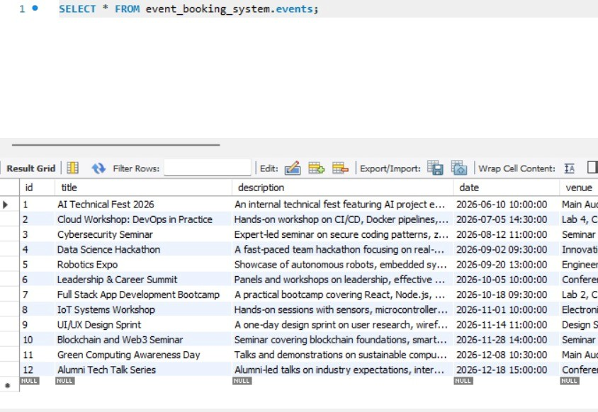
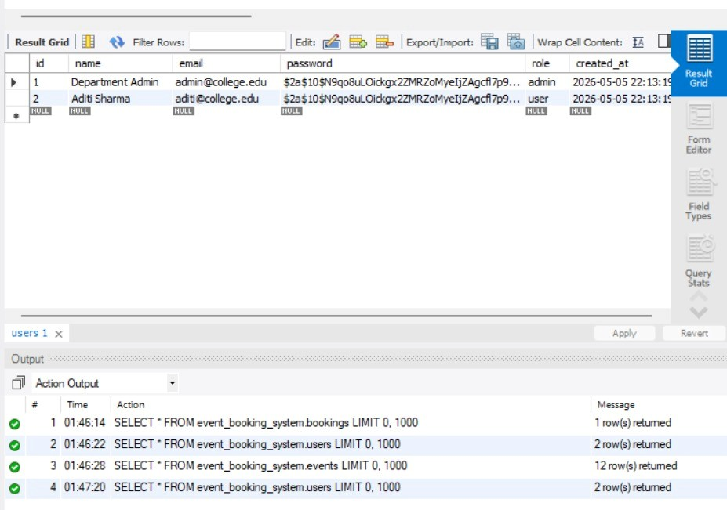
IMPLEMENTATION SCREENSHOTS
Figure:Event DB Figure:User DB
1
2
3
4
5
6
7
8(C)
9

Slide 17
ADVANTAGES & LIMITATIONS
Advantages:
Easy Ticket booking
Centralized system
Admin control
Real-time event
display
Limitations:
No real payment gateway
No database
Single admin system
No authentication security
1
2
3
4
5
6
7
8
9

Slide 18
Thank you

